Slide 1
Frequency analyzer
Cst 120
By: An c. and drew d.

Slide 2
Overview
Our project is a frequency analyzer
The input is sound, the output is the most dominant frequency

Slide 3
Build materials
128x32 OLED Screen Arduino ID: 931
Electret Microphone Amplifier -MAX4466 with Adjustable Gain ID: 1063
Microchip ATmega328P
Custom made power regulator
16 MHz crystal oscillator

Slide 4
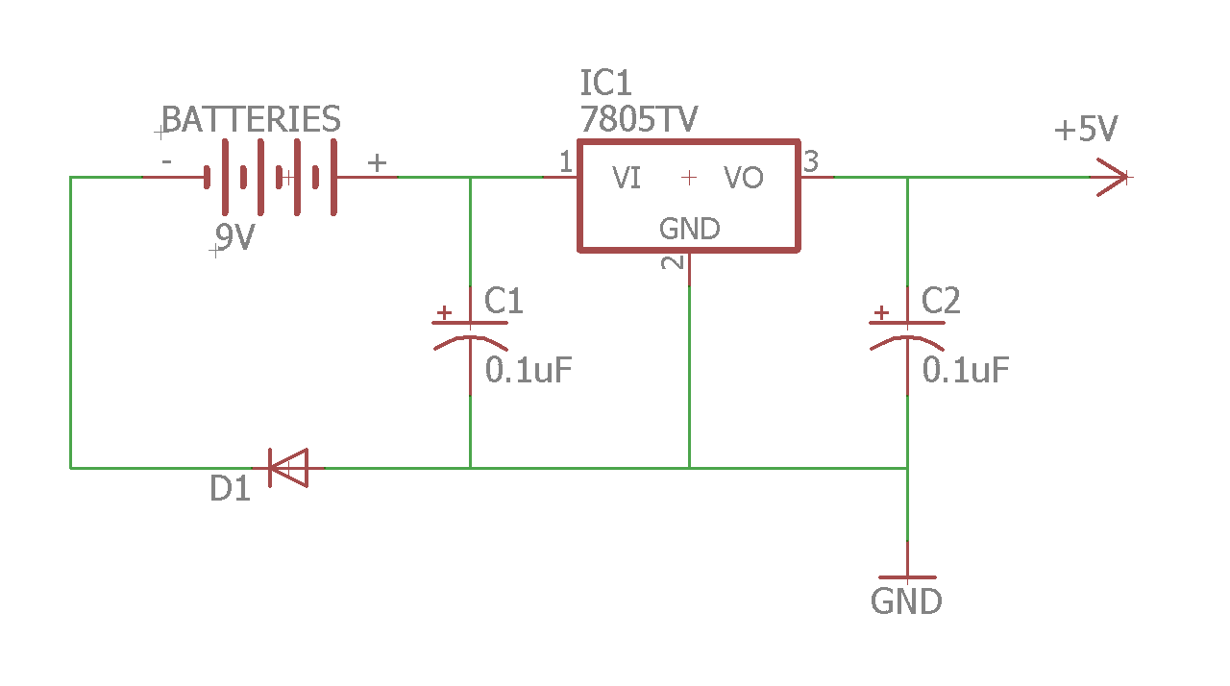

Schematic for power regulator AND SPECS
LM7805 voltage regulator
2 x 0.1 $μF capacitors$
1000V Silicone Diode

Slide 5
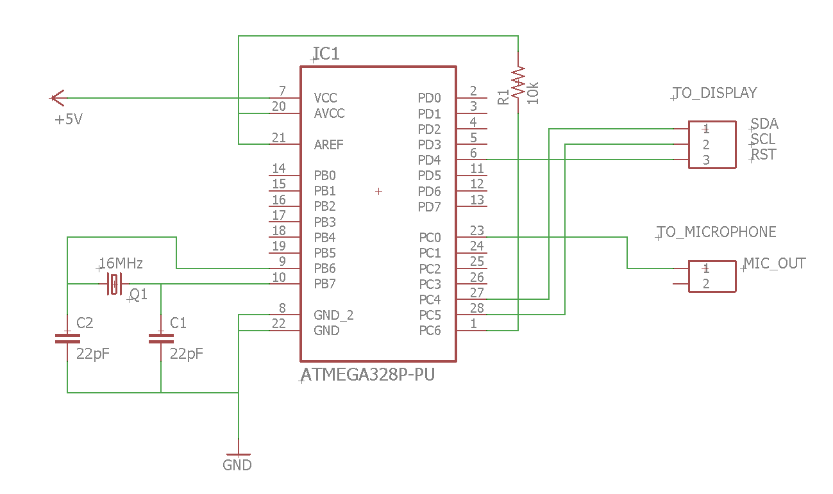
Schematic for atmega 328p
16 MHz crystal oscillator
2 x 22 pF capacitors
10kΩ resistor

Slide 6
atmega 328p specs
28-pin AVR Microcontroller
10 bit resolution ADC converter
16 MHz operational frequency
32KBytes program memory
2KBytes SRAM

Slide 7
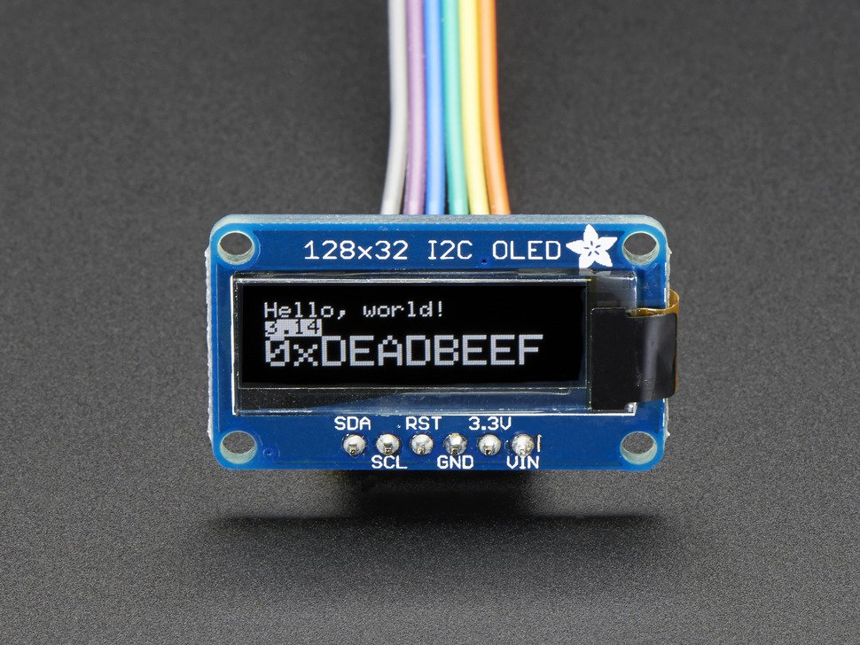
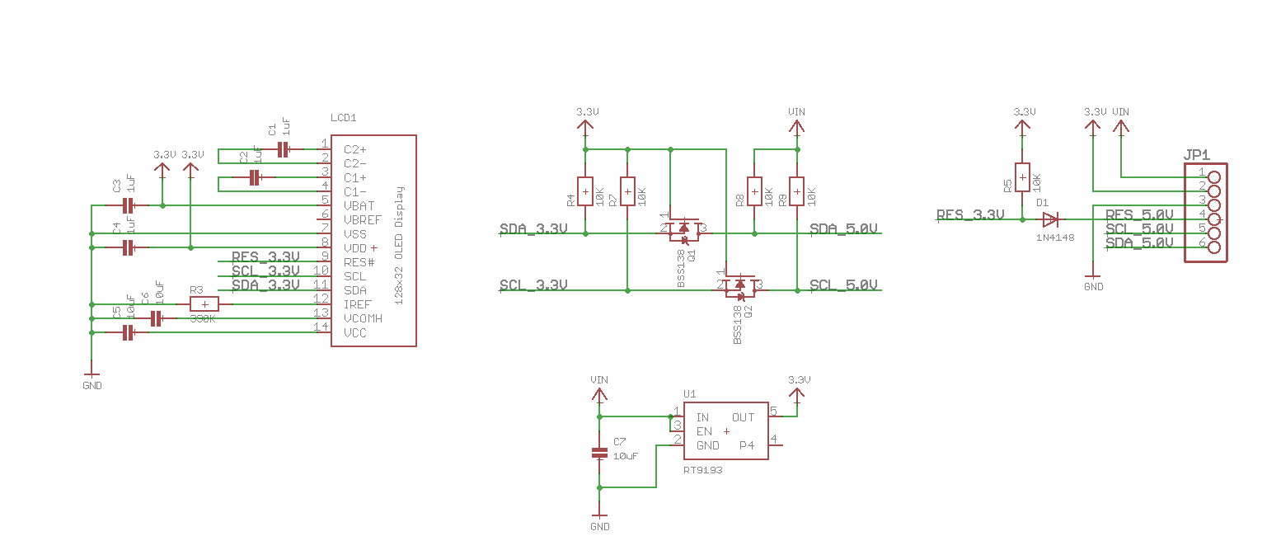
SCHEMATIC for OLED

Slide 8
OLED specs
Uses SSD 1306 driver chip to communicate with microcontroller via I2C
Screen contains 128 x 32 white OLED’s
We chose OLED because it does not require a back light, which decreases power consumption and makes it easier to run on batteries

Slide 9
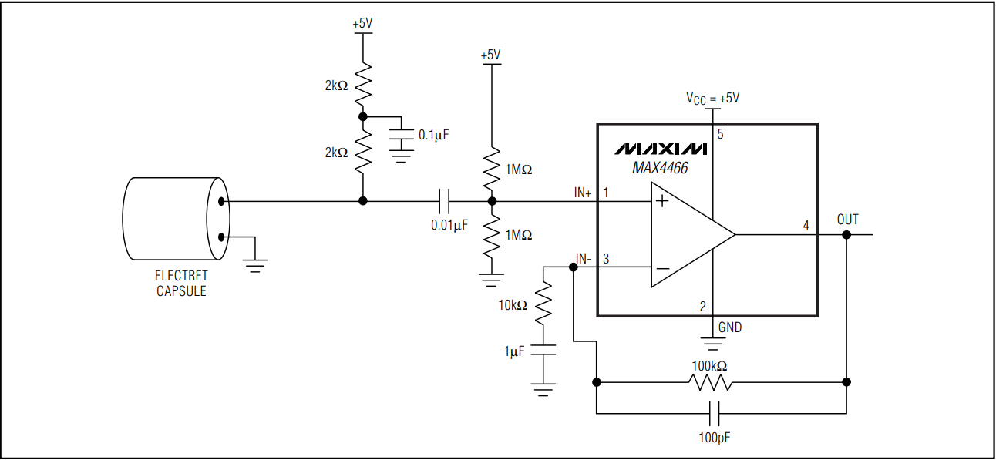
Schematic for microphone AND SPECS
Omnidirectional electret condenser microphone with operation frequency of 20-20,000 hertz
Includes a MAX 4465 op amp to amplify signal to the range 0-5 volts, centered at 2.5 for the Arduino

Slide 10
Frequency determination
How to determine frequency ?
Inflection point distance
Fast Fourier transformation (FFT)

Slide 11
Software
Included Adafruit_GFX and Adafruit_SSD1306 libraries to interface with OLED
Utilized the FFFT library for fast Fourier transformation
Utilized Arduino 8.5 IDE
Microcontroller reads in the levels of audio signals coming from the microphone at a 6KHz sample rate
A fast Fourier transformation is applied determining coefficient of each frequency range
Outputs largest coefficient in hertz

Slide 12
Possible improvements
Could add a dedicated ADC to get higher bit rate for more accurate conversion
Could add hardware high and low pass filters to remove unwanted frequency

Slide 13



demo

Slide 14
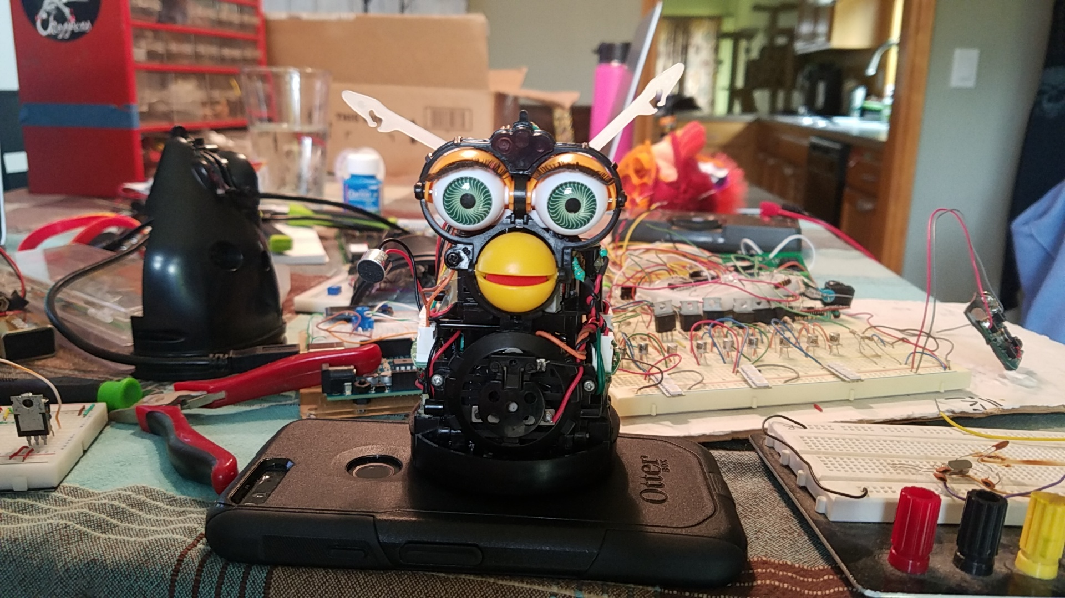
Questions?

